Slide 1
Mean-field theory and dynamical isometry of deep neural networks
Feng Wang
AIRD, Coretronic Co.
Mar 25, 2019

Slide 2
References list & slides can be find at
https://github.com/fwcore/mean-field-theory-deep-learning

Slide 3
Outlines
Introduction
Mean-field theory framework and its predictions
Initialization strategies
MLP
CNN
Architectures
ResNet
Dropout
batch normalization
Details of the theory
Assumptions
Possible pitfalls

Slide 4
Introduction
Initialization
He's & Xavier's
To enhance the information propagation
Activation functions
Dropout
BatchNorm
LSTM for RNN

Slide 5
Is there a theory for deep learning?
deep uniform neural networks
=
dynamical system
variable
width N >> 1
depth L >> 1
time t
But ...
z, y are random variables and hard to track

Slide 6
Mean-field theory for deep learning
sum of random numbers
random numbers
Mean-field treatment
mean(z) = 0
Hence we only need to track var(z)
Replace z as Gaussian
Match z's mean and variance
Law of large numbers
width N >> 1
Deep Information Propagation | arXiv:1611.01232

Slide 7
Mean-field flow of var(z)
covariance
i, j: neural index
l: layer index
a, b: sample index
is a smooth function.
However, limit c is different

Slide 8
Mean-field flow of c: a phase transition
Edge of chaos
c*=1
c*<1
Information collapse.
Gradients vanish.
Information decorrelates.
Gradients explode.
Deep Information Propagation | arXiv:1611.01232

Slide 9
Perturbation around c*
= asymptotic behavior near the edge of chaos
training accuracy
Deep Information Propagation | arXiv:1611.01232

Slide 10
Activation functions
tanh
ReLU
ELU

Slide 11
Gaussian initialization is enough?
ξ_{c} controls information propagation depth, and determines training accuracy,
How about training speed & generalization?
Edge of chaos
guarantees slow changes of correlation
Dynamical isometry
guarantees correlation preservation
Resurrecting the sigmoid in deep learning through dynamical isometry: theory and practice | arXiv:1711.04735
All singular values have norm 1

Slide 12
Dynamical isometry initialization speeds up training
test
dashed line: Gaussian
solid line: orthogonal
tanh with σ_{w}²= 1.05 (close to EOC)
tanh with σ_{w}²= 2 (far away from EOC)
ReLU with σ_{w}²= 2 (at critical point)
Resurrecting the sigmoid in deep learning through dynamical isometry: theory and practice | arXiv:1711.04735

Slide 13
Activation functions
ReLU has no dynamical isometry
tanh is better to be initialized by Orthogonal scheme with a slightly small σ_{b}²
p(s)
singular values of J
Resurrecting the sigmoid in deep learning through dynamical isometry: theory and practice | arXiv:1711.04735

Slide 14
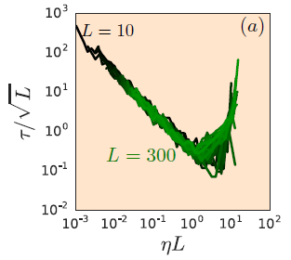
Scaling of training time
Under dynamical isometry
training time grows slower than L
optimal training rate η ~ 1/L
Resurrecting the sigmoid in deep learning through dynamical isometry: theory and practice | arXiv:1711.04735

Slide 15
Deep ConvNet
500 steps
2500 steps
training accuracy
6ξ_{c}
depth
10,000 steps
100,000 steps
Dynamical Isometry and a Mean Field Theory of CNNs: How to Train 10,000-Layer Vanilla Convolutional Neural Networks | arXiv:1806.05393
σ_{w}²

Slide 16
Dynamical isometry for deep ConvNet
Orthogonal initialization
Delta-Orthogonal initialization
performance degradation
Dynamical isometry prevents performance degradation caused by increasing depth.
Reminder: ResNet is an alternative

Slide 17
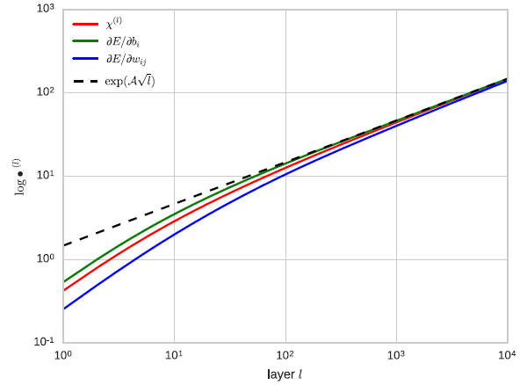
Why ResNet?
Xavier or the He initializations are not optimal for residual networks
the optimal initialization variances depend on the depth
Mean Field Residual Networks: On the Edge of Chaos | arXiv:1712.08969

Slide 18
Dropout limits the depth
without dropout
with dropout
Deep Information Propagation | arXiv:1611.01232

Slide 19
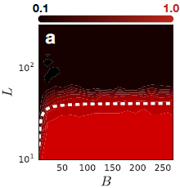
Batch normalization limits the depth
Method to overcome
Gradient explosion can be reduced by tuning the network close to the linear regime
16ξ_{c}
A Mean Field Theory of Batch Normalization | [arXiv:1902.08129]

Slide 20
Outlines
Introduction
Mean-field theory framework and its predictions
Initialization strategies
MLP
CNN
Architectures
ResNet
Dropout
batch normalization
Details of the theory
Assumptions
Possible pitfalls

Slide 21
Mean-field theory Assumptions
deep uniform neural networks
=
dynamical system
variable
width N >> 1
Assumptions
Uniform layers (constant N)
independent weights for forward & back propogation
N >> 1
L >> 1
theory works only for untrained model (time t = layer number ≠ epoch)
depth L >> 1
time t

Slide 22
Mean-field theory limitations/pitfalls
Theory works only for untrained model (time t = layer number ≠ epoch)
Orthogonal initialization ≠ dynamical isometry necessary but not sufficient
May not work if width is small
May not work for shallow networks
Not theory on generalization/test performance, training speed only on information propogation

Slide 23
Summary
Mean-field theory (MFT) describes information propogation.
MFT determine the maximal training depth.
Initialization at the edge of chaos unlimits the training depth.
Dynamical isometry speeds up training, and prevents test accuracy degradation with depth.
Orthogonal initialization is a powerful scheme to reach dynamical isometry.
BatchNorm and dropout limit the training depth.
ReLU has no dynamical isometry.

